Slide 1

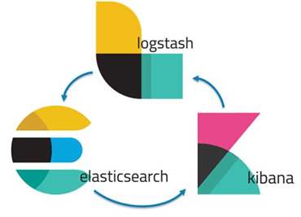




BLUE TEAM
Summary of Operations
E L K Stack

Slide 2


Table of Contents
Review of Critical
Vulnerabilities
Alerts Implemented
Hardening
Implementing Patches

Slide 3
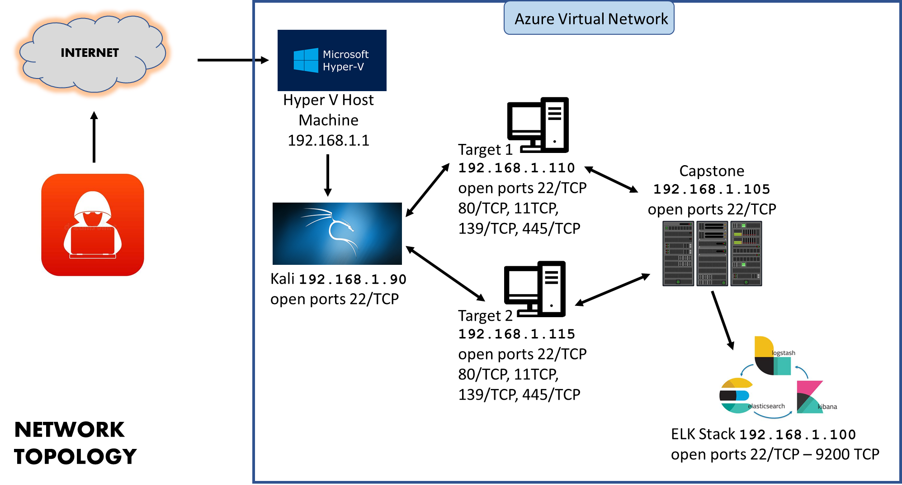

Slide 4
Review of Critical
Vulnerabilities
Weak password
Michael, using his own name for a password, allowed for effortless ssh port exploitation.
Exposed user password hashes
Reverse engineering the hash has the potential to also unauthorized access to the system.
WordPress Enumeration
A wpscan enumeration scan can exploit vulnerabilities in the WordPress database and find usernames.
Escalated root privileges with the use of a python script
Open and unrestricted ssh access via ports
This has the potential to escalate the privileges of an unauthorized user.
Open access ports can increase the amount of unwanted traffic and leaves the system vulnerable to exploitation.

Slide 5
Alerts Implemented
SSH Login Alert
SSH Port monitored for unauthorized access.
Triggers when user attempts to access any ports 22 or higher.
MySQL Database Alert
The MySQL database will be monitored for unauthorized attempts to access. Triggers when an external/unauthorized IP connections attempts to access the SQL Database or any related files.
Privilege Escalation Alert
Monitors root/sudo activity. Triggers when unauthorized sudo command usage or privileged directory access is attempted by an unauthorized user.

Slide 6

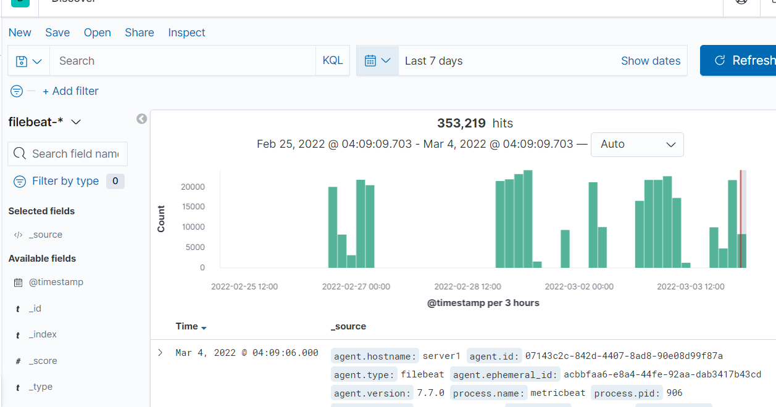

Slide 7
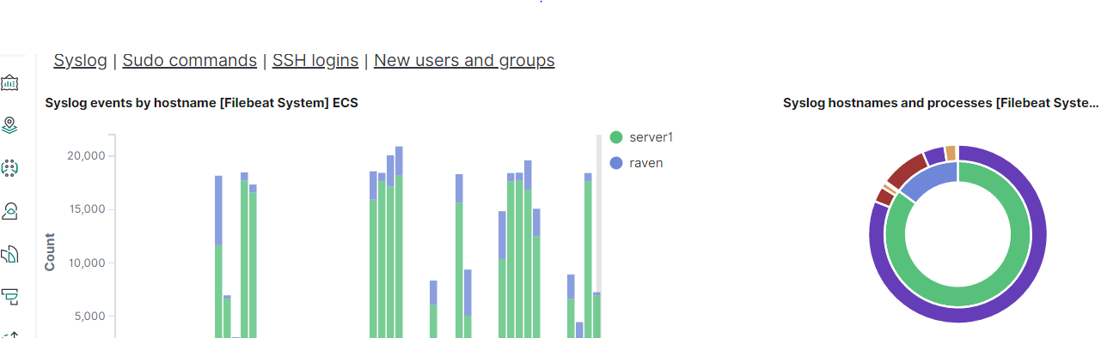

Slide 8
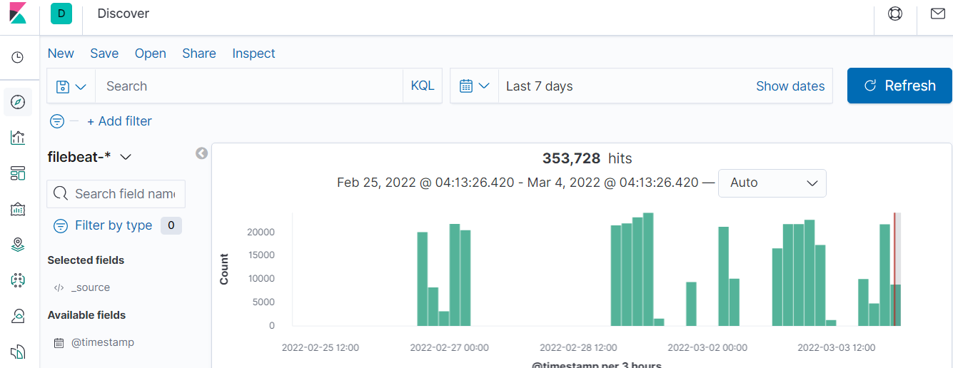

Slide 9



